Slide 1











DS PGC SQL PROJECT
QUERIES, RESULTS & OUTPUTS – INSIGHTS & RECOMMENDATIONS
VIDEO EXPLANATION:
HTTPS://DRIVE.GOOGLE.COM/FILE/D/19VB7JFL5IYJ0YMWDUPG5VK0GXW5OPYQ M/VIEW?USP=SHARING
PANKAJ SHARMA

Slide 2
TASK 1: QUERY
WITH cte AS (SELECT DISTINCT branch,
DATE_FORMAT(date,'%m') AS month,
ROUND(SUM(total)) AS total_sales_per_month FROM walmart
GROUP BY branch, month ORDER BY branch,month)
SELECT branch,
month,
total_sales_per_month,
LEAD(total_sales_per_month,2) OVER (PARTITION BY branch) AS total_sales_in_3rd_month, ROUND((LEAD(total_sales_per_month,2) OVER (PARTITION BY branch) -
total_sales_per_month)/total_sales_per_month*100,2) AS
growth_rate
FROM cte;

Slide 3
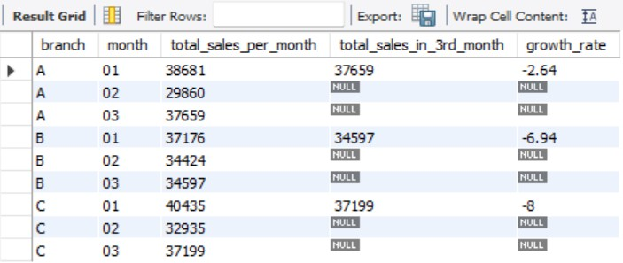
TASK 1: OUTPUT
In the output we can observe the following
Branches A,B,C.
Months – 1,2,3.
Total Sales Per Month Per Branch
Last(3rd) Month Sales
Growth Rate as A (-2.64%),B (-6.94%),C(-8%).
Conclusion: It can be concluded that comparatively highest growth rate is for Branch A between 1st month and last(3rd) month. (though it is negative).

Slide 4
TASK 2: QUERY
SELECT branch,
product_line, ROUND(SUM(gross_income)) AS income,
RANK() OVER(PARTITION BY branch ORDER BY SUM(gross_income) DESC) AS product_line_rank
FROM Walmart
GROUP BY branch, product_line ORDER BY branch, product_line;

Slide 5
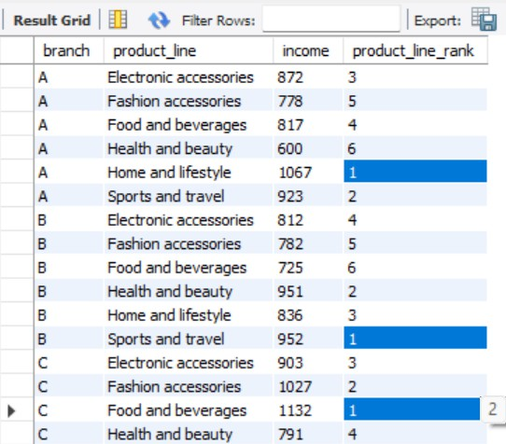
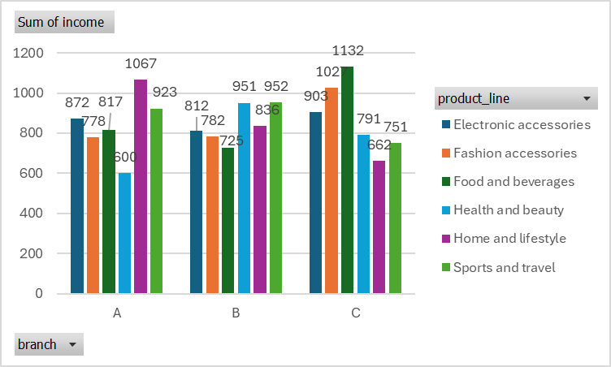
From output
There are 3 branches & 6 product lines.
The income has been ranked from 1 to 6.
For branch A, ‘Home & lifestyle’ generates highest income.
For branch B, ‘Sports & travel’ & ‘Health & beauty’ generate highest
income. Both are close.
TASK 2: OUTPUT
For branch C, ‘Food & beverages’ generate highest income.

Slide 6
TASK 3: QUERY
SELECT branch,
product_line,
ROUND(SUM(total)) AS total_sales,
CASE WHEN ROUND(SUM(total)) > 20000 THEN 'High Spending' WHEN ROUND(SUM(total)) < 15000 THEN 'Low Spending'
ELSE 'Medium Spending’
END AS spending_level FROM Walmart
GROUP BY branch,product_line
ORDER BY branch,product_line;

Slide 7
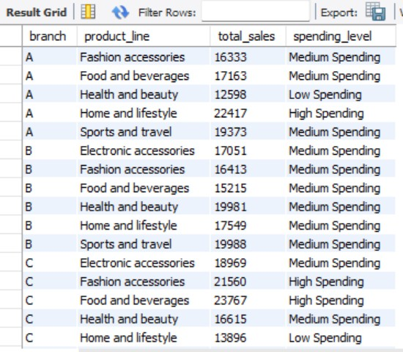
TASK 3: OUTPUT
In the Output
The Sales against each product_line in each branch is shown under total_sales.
Total Sales above 20000 is marked as ‘High Spending’.
below 15000 as ‘Low spending’ and
remaining as ‘Medium Spending’.

Slide 8
TASK 4: QUERY
SELECT product_line,
ROUND(AVG(total)) AS avg_sales, ROUND(MAX(total)) AS maximum_sale, ROUND(MIN(total)) AS minimim_sale
FROM Walmart GROUP BY product_line ORDER BY product_line;

Slide 9
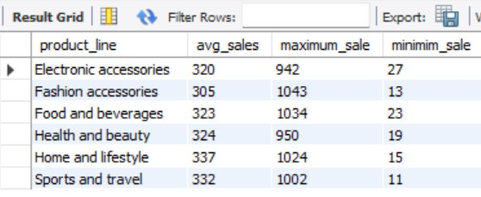
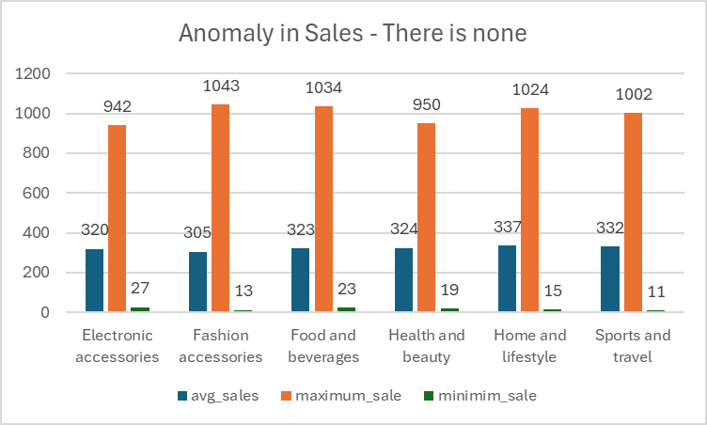
In the Output
For every product line the ‘avg sales’ is between 300 & 350.
TASK 4: OUTPUT
Maximum sale is between 950 & 1050.
Minimum Sale is between 10-30.
It can be observed that there is no unusually high or low sales happening for any of the product line. Eg,
100k or –ve sales transaction etc
So, there is no anomaly in any transactions for 3 branches & 6 product linesof Walmart.

Slide 10
TASK 5: QUERY
SELECT city,
payment AS payment_method,
COUNT(total) AS No_of_transactions,
RANK() OVER(PARTITION BY city ORDER BY COUNT(total) DESC) AS rank_of_payment_method
FROM Walmart
GROUP BY city,payment_method
ORDER BY city,payment_method;

Slide 11
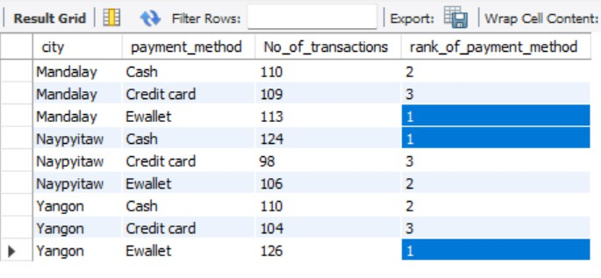
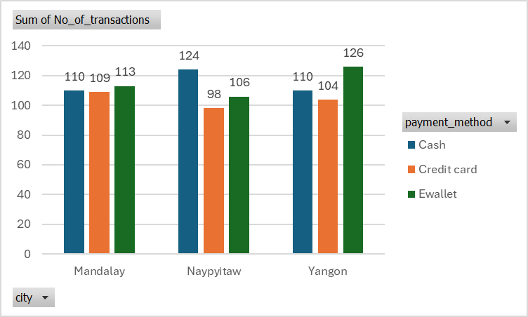
From the output
Cities – 3 – Mandalay, Naypyitaw, Yangon
Payment methods – 3 – Cash, Credit Card, Ewallet
For Mandalay city, the 3 methods are close by ~110.
For Naypyitaw city, cash transactions are relatively more ~124.
For Yangon city, Ewallet transactions are higher ~126.
TASK 5: OUTPUT

Slide 12
TASK 6: QUERY
SELECT gender,
DATE_FORMAT(date,'%m') AS month, ROUND(SUM(total)) AS total_sales
FROM Walmart
GROUP BY gender,month
ORDER BY gender,month;

Slide 13
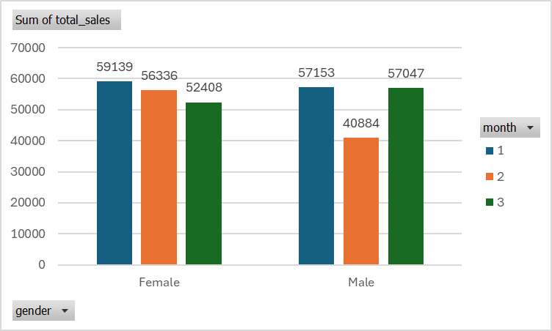
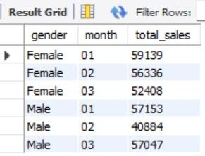
TASK 6: OUTPUT
From the output
The distribution of total sales for both the Genders Male, Female is even i.e between 50k to 60k.
There is only one exception to the rule i.e for male in 2nd Month (Feb) the sales is below the
range i.e ~40k.

Slide 14
TASK 7: QUERY
SELECT customer_type,
product_line,
COUNT(product_line) AS no_of_customers
FROM Walmart
GROUP BY customer_type,product_line ORDER BY customer_type,product_line;

Slide 15
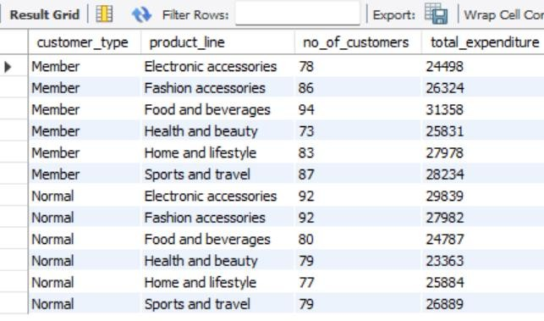
TASK 7: OUTPUT
From the output
It is clear that the no of customers of each type (Member or Normal) are preferring each product line equally.
No of Customers - The distribution is even & is between ~75-95 for each product line.
Total expenditure by each type of customer across product line is again between ~25k to ~30k.
So the preference by both type of customers for all product lines is even. There is no Specific relation that can be found.

Slide 16
TASK 8: QUERY
WITH cte AS (SELECT product_line,
DATE_FORMAT(date,'%Y-%m-%d') AS dates,
COUNT(product_line) AS no_of_purchases
FROM walmart
GROUP BY product_line,dates
ORDER BY product_line,dates) SELECT product_line,
SUM(no_of_purchases) AS total_purchases
FROM cte
WHERE dates BETWEEN dates AND DATE_ADD(dates,INTERVAL 30 DAY)
GROUP BY product_line;

Slide 17
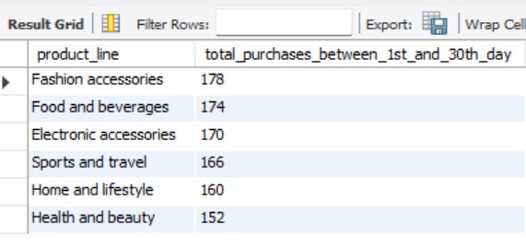
TASK 8: OUTPUT
From the output
We can see that from day 1 to 30th Day the total purchases for the 6 product lines are between 152 – 178.

Slide 18
TASK 9: QUERY
WITH ranked_revenue AS ( SELECT product_line,
ROUND(SUM(total)) AS total_revenue,
RANK() OVER(ORDER BY SUM(total) DESC) AS revenue_rank
FROM walmart
GROUP BY product_line)
SELECT product_line,
total_revenue,
revenue_rank
FROM ranked_revenue
WHERE revenue_rank <= 3;

Slide 19
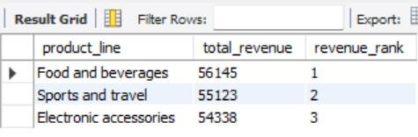
TASK 9: OUTPUT
From the Output
As customer details were not available.
We can see top 3 product lines by revenue.
1st – Food & beverages
2nd – Sports & Travel
3rd – Electronic Accessories

Slide 20
TASK 10: QUERY
SELECT DISTINCT DAYNAME(date) AS week_day,
ROUND(SUM(total)) AS total_sales FROM Walmart
GROUP BY week_day
ORDER BY total_sales DESC;

Slide 21
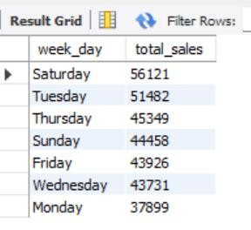
TASK 10: OUTPUT
From the output
It is clear that highest revenue by sales is generated on Saturday.
Lowest sales is on Monday.
It can be concluded that people purchase more on Saturday.

Slide 22
FINDINGS & INSIGHTS
It can be concluded that comparatively highest growth rate is for Branch A between 1 ^{st} month and last(3rd) month. (though it is negative).
There are 3 branches & 6 product lines. The income has been ranked from 1 to 6. For branch A, ‘Home & lifestyle’ generates highest income. For branch B,
‘Sports & travel’ & ‘Health & beauty’ generate highest income. Both are close. For branch C, ‘Food & beverages’ generate highest income.
For every product line the ‘avg sales’ is between 300 & 350. Maximum sale is between 950 & 1050. Minimum Sale is between 10 -30.
It can be observed that there is no unusually high or low sales happening for any of the product line. Eg, 100k or –ve sales transaction etc. So, there is no anomaly in any transactions for 3 branches & 6 product lines of Walmart.
Cities – 3 – Mandalay, Naypyitaw, Yangon. Payment methods – 3 – Cash, Credit Card, Ewallet. For Mandalay city, the 3 methods are close by ~110. For Naypyitaw city, cash transactions are relatively more ~124. For Yangon city, Ewallet transactions are higher ~126.
The distribution of total sales for both the Genders Male, Female is even i.e between 50k to 60k. There is only one exception to the rule i.e for male in 2nd Month (Feb) the sales is below the range i.e ~40k.
It is clear that the no of customers of each type (Member or Normal) are preferring each product line equally. No of Customer s - The distribution is even & is between ~75-95 for each product line. Total expenditure by each type of customer across product line is again between ~25k to ~30k. So the preference by both type of customers for all product lines is even. There is no Specific relation that can be found.
We can see that from day 1 to 30th Day the total purchases for the 6 product lines are between 152 – 178.
We can see top 3 product lines by revenue. 1st – Food & beverages. 2nd – Sports & Travel. 3rd – Electronic Accessories
It is clear that highest revenue by sales is generated on Saturday. Lowest sales is on Monday. It can be concluded that peopl e purchase more on Saturday.

Slide 23
RECOMMENDATIONS – TO INCREASE SALES, CUSTOMER ENGAGEMENT & OPERATIONAL EFFICIENCY
Branch-Specific Promotions:
Branch A: Since "Home & Lifestyle" generates the highest revenue, focus promotions and marketing efforts on expanding the product ran ge and enhancing visibility in this category.
Branch B: Both "Sports & Travel" and "Health & Beauty" are performing well, so these product lines should be prioritized for bundled promotions, seasonal discounts, or
loyalty programs.
Branch C: "Food & Beverages" is the top-performing category, so introducing combo deals, special pricing, or adding more premium products might further boost sales.
Product Line-Specific Strategies:
Since the average sales across all product lines are relatively similar (between 300 -350), explore cross-promotion opportunities. For example, combine lower-performing product lines with higher performers, such as offering discounts on "Electronic Accessories" with "Food & Beverages" purchases.
With "Food & Beverages" being the top revenue earner, consider allocating more inventory or introducing unique products in th is category to maintain momentum.
Targeted Sales Strategies Based on Cities:
Mandalay: Since all payment methods are evenly distributed, continue offering multiple payment options. Introduce e-wallet cashback offers to increase digital payments.
Naypyitaw: Cash transactions are relatively higher, indicating a preference for traditional payments. Offering incentives for digital payment methods (like discounts for credit card or e-wallet payments) may increase the adoption of non-cash payments.
Yangon: E-wallet is the preferred method here. This city would benefit from partnerships with e-wallet providers to offer exclusive rewards or cashback, further boosting customer engagement.

Slide 24
RECOMMENDATIONS – TO INCREASE SALES, CUSTOMER ENGAGEMENT & OPERATIONAL EFFICIENCY
Customer Segmentation Insights:
Sales are evenly distributed between both genders, with the exception of February, where male sales are slightly lower. Speci al promotions targeted at male customers during this period, such as loyalty points or discounts, could help balance the sales distribution.
As both "Member" and "Normal" customers are equally distributed across all product lines, further differentiation in membersh ip benefits (e.g., early access to sales or
exclusive product launches) could drive membership growth.
Day-Specific Marketing:
Highest Sales on Saturday: Since Saturday is the most profitable day, maximize sales through special weekend offers, flash sales, or exclusive promotions. Advertising efforts should peak leading up to the weekend.
Lowest Sales on Monday: Since Monday is the slowest day, launch campaigns to boost sales at the beginning of the week. Offering "Monday Blues Disco unts" or incentives like double loyalty points could attract more customers.
Customer Purchase Behavior:
With total purchases between day 1 and day 30 ranging from 152 -178, maintaining consistent product availability is critical.
This suggests demand remains stable throughout the month, so inventory replenishment should follow a steady schedule, with sl ight increases near the end of the month.

